Slide 1
Symptom-Based Disease Identification from Clinical Text Using Fuzzy C-Means and TF-IDF Clustering -A Research Presentation

Slide 2
Agenda
Abstract
Introduction
Literature Review
Methodology
Comparative Analysis
Results and Visualization
Final tips & takeaways

Slide 3
Abstract
This study introduces a novel approach to identifying diseases based on free-text symptom descriptions using TF-IDF feature extraction and Fuzzy C-Means clustering. It enables soft clustering, allowing overlap between disease groups, and is visualized using PCA and Power BI dashboards. The system outperforms traditional K-Means in interpretability and flexibility

Slide 4
Introduction
Clinical symptom data is often unstructured and ambiguous
Traditional models rely on structured inputs and hard classifications
This paper uses TF-IDF and Fuzzy C-Means to allow soft, interpretable clustering
Useful for cases where symptoms overlap across diseases

Slide 5
Literature Review
TF-IDF is widely used in healthcare text analysis
Deep models (LSTM, CNN) provide hard labels
FCM applied on structured data previously (e.g., Gupta 2018)
No prior work combines TF-IDF + FCM for free-text symptom clustering

Slide 6
Methodology
Data Cleaning
2. TF-IDF vectorization (100 top features)
3. Fuzzy C-Means clustering (4 clusters, m=2)
4. PCA visualization of clusters
5. Output to Power BI dashboard

Slide 7
Comparative Analysis
K-Means: Hard clustering, less interpretability
FCM: Soft clustering, better for ambiguous symptoms
TF-IDF + FCM handles free-text input flexibly
More aligned with real clinical uncertainty

Slide 8
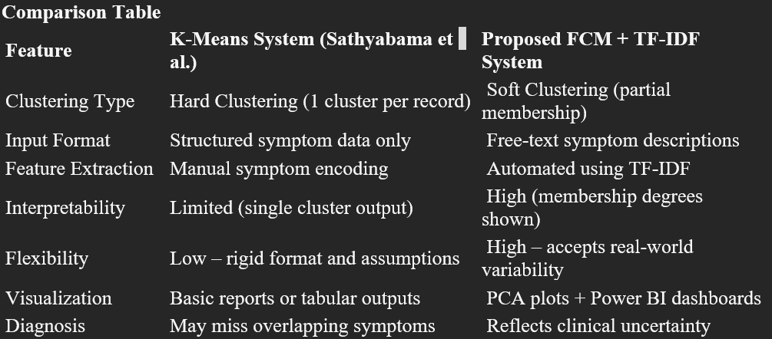

Slide 9
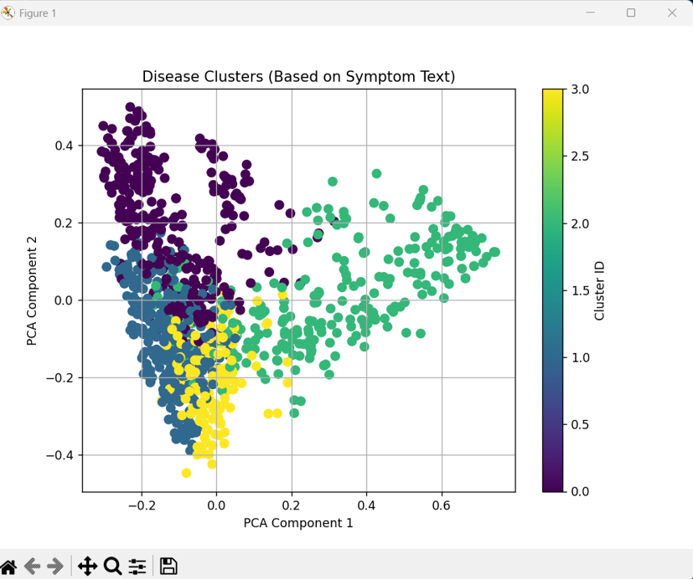
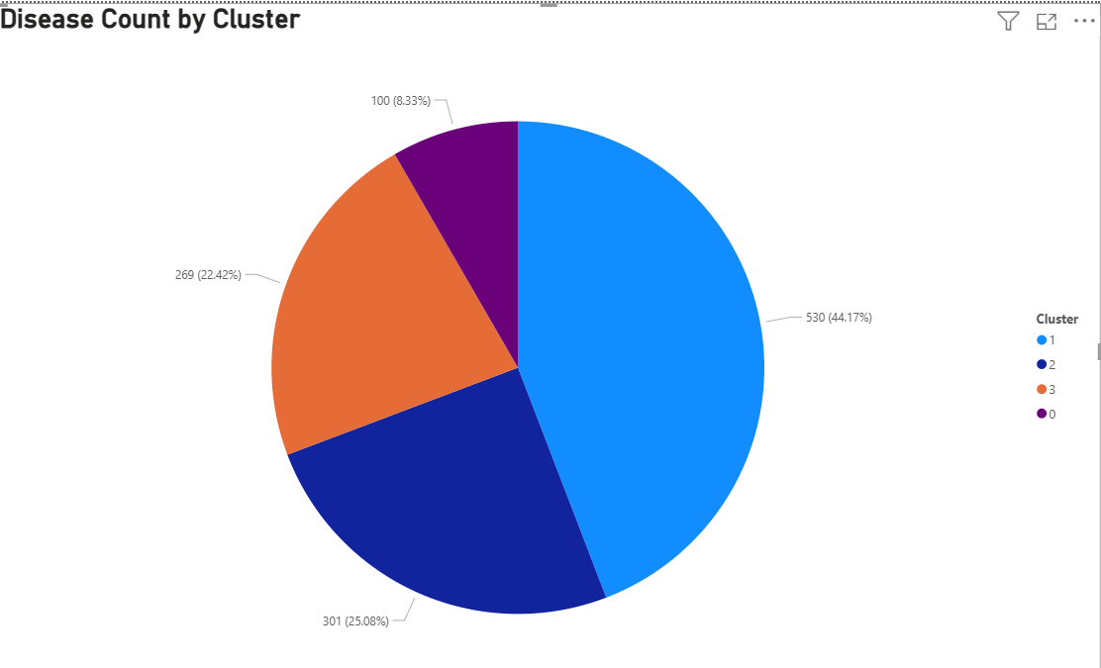
Results & Visualization
• PCA shows well-separated fuzzy clusters
• Each case belongs to multiple clusters
• Output integrated into Power BI for dynamic filtering and analysis

Slide 10
Final tips & takeaways
Seek feedback
Reflect on performance
Explore new techniques
Set personal goals
Iterate and adapt
Novel framework for text-based disease clustering
More interpretable than neural networks
Future: Use BERT embeddings, expand to multilingual datasets
Apply to real hospital symptom logs

Slide 11
Thank you

